Slide 1
Violence Detection in Surveillance System
Ain Shams University
Faculty of Computer & Information Sciences
Computer Systems Department

Slide 2
Supervisor : Dr. Karim Omara
T.A: Dr. Omar Khaled
Team members:
Basma Khaled Mahmoud
Ali Osama Ali Ebrahim
Ahmed Mohamed Mohamed Taha
Shahd Hany Elsayed
Abdelrahman Ahmed Ezzat
Karim Hossam Elsayed

Slide 3

Agenda
Introduction
Problem Statement
Objective
Survey
System Architecture
Alert Module
SW & HW Requirements
Timeplan
References

Slide 4
Introduction
Preserving and enhancing public security is a critical issue for governments and law enforcement agencies. One of the primary tools in the fight against crime is CCTV surveillance.
With the rapid growth of security cameras in public places like schools, hospitals, banks, and streets, manually monitoring large amounts of video data has become extremely difficult and inefficient.
Automated violence detection systems are therefore essential to assist human operators, improve response times, and enhance overall public safety.

Slide 5
Introduction
Violence detection draws from multiple fields including Computer Vision, Action Recognition, and Digital Signal Processing. Approaches have evolved from non-deep learning approaches (STIP, MoSIFT) to deep learning approaches (CNN+LSTM, 3D CNNs) that can learn complex patterns directly from video data.
Our vision is to assist governments in enhancing public security through AI-powered CCTV systems that automatically detect violent behavior and enable faster intervention.

Slide 6
Problem Statement
Public violence often go unnoticed until damage is already done because traditional surveillance only records footage without real-time alerts.
The massive volume of real-time CCTV footage overwhelms human operators, who often miss critical threats like weapons or early aggression in crowded feeds.
This delay prevents quick emergency response and increases risks to civilians.
Research shows operators miss 95% of critical CCTV activity after only 22 minutes of continuous monitoring (COM-SUR).

Slide 7
Objective
The goal of this work is to processes video signals to extract high-level representations and makes informed decisions based on this data. These decisions include sending real-time alerts or warnings to security personnel and saving video segments as evidence.
A web-based dashboard allows users to interact with the system, monitor alerts in real-time, and quickly access stored video evidence.

Slide 8
Survey
Violence Recognition from Videos using Deep Learning Techniques
Published in 2019
By Mohamed Mostafa Soliman, Youssef Mohamed Mostafa, Mohamed Hussein Kamal, Bassel Safwat Chawky, Mina Abd El-Massih Nashed, Dr. Dina Khattab
The paper presents an end-to-end deep learning model for recognizing violent actions in videos.
It uses VGG-16 model, LSTM, and fully connected layers. A dataset, RLVS, with 2000 videos, is introduced to improve generalization.
The model achieves accuracy of 88.2%

Slide 9
Survey
Real-Time CCTV Violence Detection Automation System
Published in June 2025
By Atharva Deshmukh, Vaishnavi Dayama, Shubham Mane, Shantanu Savaji,
Prof. Priyanka Khalate
This paper introduces a real-time CCTV violence detection system that uses deep learning (CNN and LSTM models) to automatically identify violent activities from video streams.
Datasets, RLVS, SFD is introduced to improve generalization.

Slide 10
System Architecture
To detect violent behavior in video streams, the system must extract features that represent both the visual appearance features and the motion features occurring over time.
Therefore, we need to add two categories of modules:
Spatial Feature extraction Module
Temporal Feature extraction Module

Slide 11
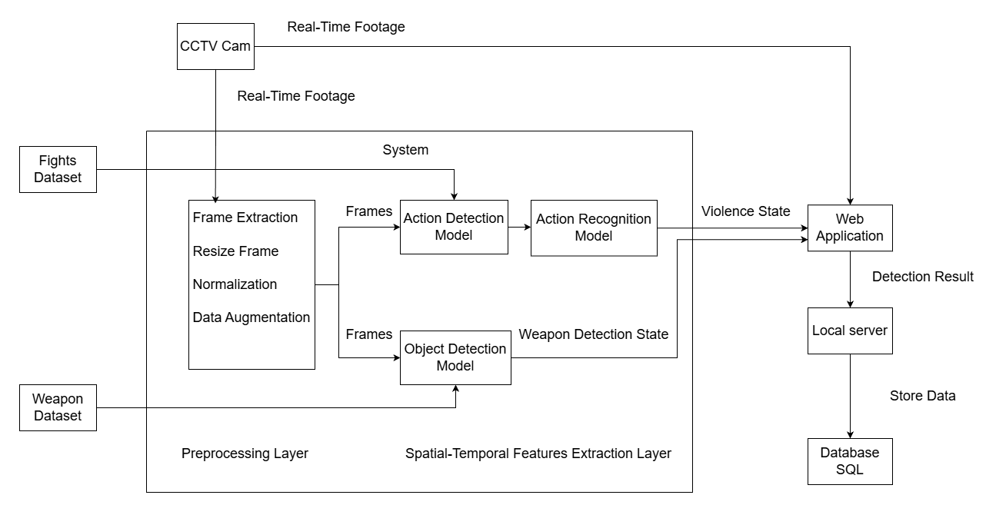
System Architecture

Slide 12
System Architecture: Alert module
The main goal of the alert module is to:
Receive real-time alerts from the AI model whenever violence or weapon usage is detected.
Notify authorized users through the web dashboard.
Enable operators to review incident details.

Slide 13
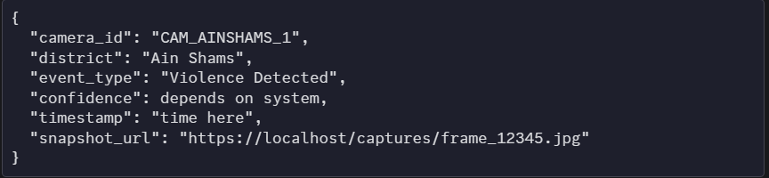
System Architecture: Alert module
The detection system sends JSON data containing:

Slide 14
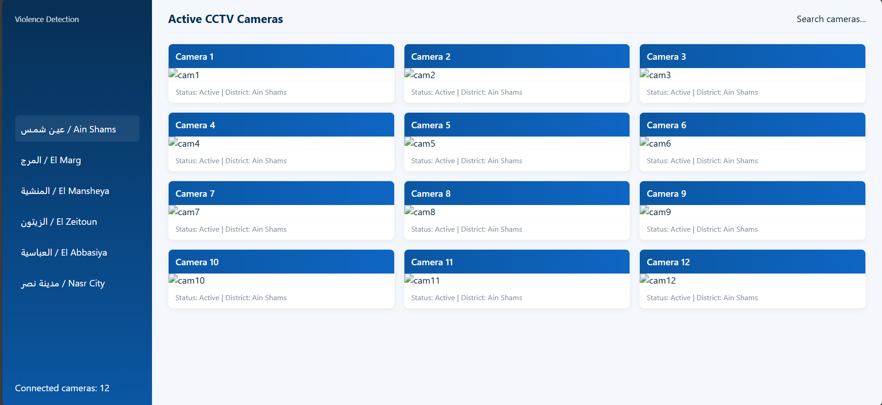
System Architecture: Alert module

Slide 15
System Architecture: Datasets
Smart-City CCTV Violence Detection Dataset (SCVD) – Kaggle
Collected by: Aremu et al. as part of smart-city CCTV surveillance research.
What it contains:
The dataset contains CCTV-style videos of violent actions and a unique class for weapon detection, where any handheld object capable of causing harm is labeled as a weapon making it the first video-based weapons dataset.

Slide 16

Software Requirements
IDE tools :
Visual Studio Code
Google Colab
Video Manipulation Library :
OpenCV
Deep Learning Frameworks :
TensorFlow
PyTorch

Slide 17
Software Requirements
Libraries :
NumPy
MatPlotLib
GUI Library :
Tkinter
Deep Learning Models :
CNN+LSTM
YOLOv8

Slide 18


Hardware Requirements
+
CCTV cameras
Backend Server

Slide 19

Hardware Requirements
Many CCTV cameras recording & doing processing in the Backend Server.
Each camera will have an IP address.
Camera footage can be accessed by RTSP (Real Time Streaming Protocol).

Slide 20
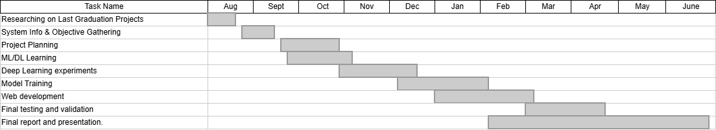
Timeplan

Slide 21
References
By Mohamed et al. (2019) Violence Recognition from Videos using Deep Learning Techniques
By Atharva et al. (2025) Real-Time CCTV Violence Detection Automation System
By Aremu et al. (2024) Smart-City CCTV Violence Detection Dataset (SCVD) on Kaggle

Slide 22
Thank You

